Slide 1
Radio-Interferometric Measurement Equation Introductory Radio Interferometry Course Radio Astronomy Techniques and Technologies Group (RATT) Rhodes University
Modhurita Mitra
February 18, 2015

Slide 2
Radio-Interferometric Measurement Equation (RIME)
Compact, intuitive, matrix-based way of representing propagation effects in radio interferometry.
Useful for calibration (solving for and correcting these propagation effects).

Slide 3

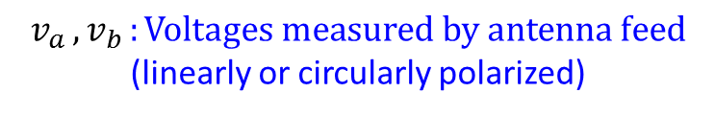
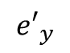
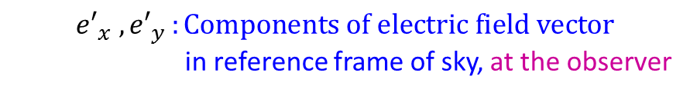
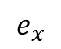
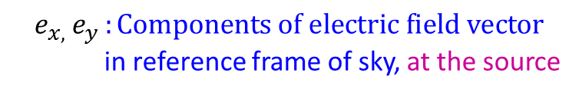
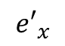
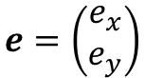
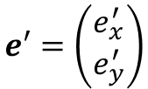
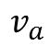
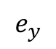
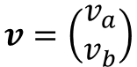
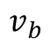
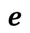
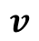
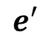
Introduction
$${{e′}_{x} , e′}_{y }:Components of electric field vector$$
in reference frame of sky, at the observer
Source
$${v_{a },v}_{b }:Voltages measured by antenna feed$$
(linearly or circularly polarized)
Propagation effects
$$e_{y}$$
$$e$$
$$e_{x}$$
$${e_{x, }e}_{y }:Components of electric field vector$$
in reference frame of sky, at the source
$$v$$
$$e′$$
$${e′}_{y}$$
$$v_{b}$$
$$e=\left(\begin{matrix}e_{x} \\ e_{y}\end{matrix}\right)$$
$$v_{a}$$
$${e′}_{x}$$
Can be represented
as vectors:
$$e′=\left(\begin{matrix}e_{x}^{′} \\ e_{y}^{′}\end{matrix}\right)$$
Antenna
$$v=\left(\begin{matrix}v_{a} \\ v_{b}\end{matrix}\right)$$

Slide 4
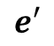
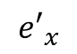
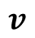
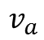
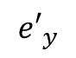
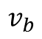
Propagation effects absent
Source
Amplitude and direction of electric vector
remain unchanged during propagation
$$v_{b}$$
No propagation effects
$$e_{y}$$
$$v$$
$$e$$
$$e_{x}$$
$$v_{a}$$
$${e′}_{y}$$
$$e′$$
$${e′}_{x}$$
Antenna

Slide 5
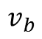
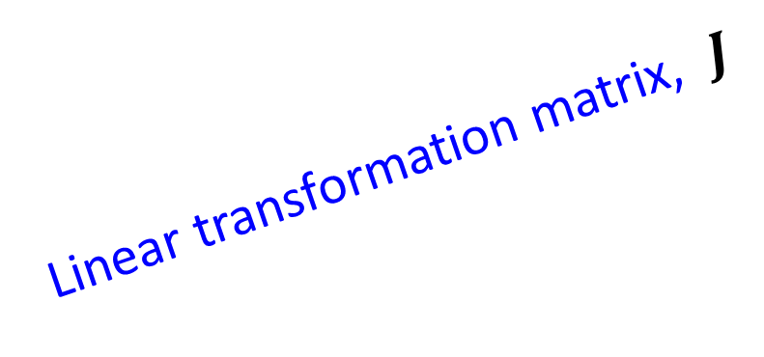
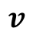
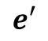
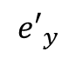
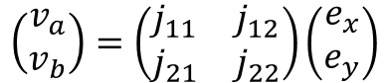
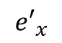
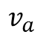
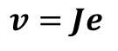
Propagation effects present
Source
Amplitude and direction of electric vector
change during propagation
Propagation effects
$$e_{y}$$
$$v$$
$$e$$
$$v_{b}$$
$$e_{x}$$
$$v_{a}$$
Linear transformation matrix, $J$
$${e′}_{y}$$
$$e′$$
Jones matrix
$${e′}_{x}$$
Voltage vector
$$v=Je$$
Electric field vector
$$\left(\begin{matrix}v_{a} \\ v_{b}\end{matrix}\right)=\left(\begin{matrix}j_{11} & j_{12} \\ j_{21} & j_{22}\end{matrix}\right)\left(\begin{matrix}e_{x} \\ e_{y}\end{matrix}\right)$$
Antenna

Slide 6
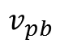
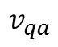
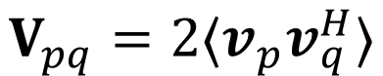
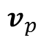
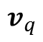
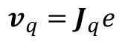
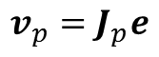
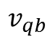
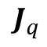
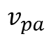
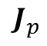
Correlation
Source
Antenna p
$$J_{p}$$
$$v_{p}=J_{p}e$$
$$v_{p}$$
$$e_{y}$$
$$v_{pb}$$
$$e$$
$$v_{pa}$$
$$e_{x}$$
Correlator
$$J_{q}$$
Antenna q
$$v_{qb}$$
$$v_{q}=J_{q}e$$
$$v_{q}$$
$$v_{qa}$$
$$V_{pq}=2⟨v_{p}v_{q}^{H}⟩$$

Slide 7
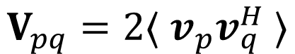
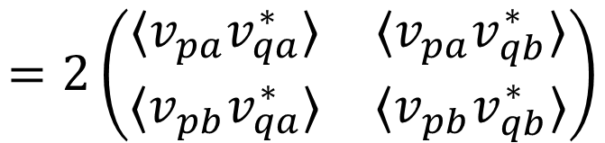
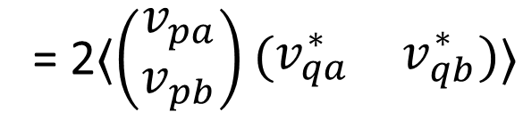
Visibility
The correlator computes the visibility, $V_{pq}$, on the baseline $pq$:
Hermitian conjugate
Outer product
$$V_{pq}=2⟨ v_{p}v_{q}^{H} ⟩$$
These 4 quantities are the outputs from the correlator
Average
= 2$⟨\left(\begin{matrix}v_{pa} \\ v_{pb}\end{matrix}\right)\left(\begin{matrix}v_{qa}^{∗} & v_{qb}^{∗}\end{matrix}\right)⟩$
$$=2\left(\begin{matrix}{⟨v}_{pa}v_{qa}^{∗}⟩ & {⟨v}_{pa}v_{qb}^{∗}⟩ \\ {⟨v}_{pb}v_{qa}^{∗}⟩ & {⟨v}_{pb}v_{qb}^{∗}⟩\end{matrix}\right)$$

Slide 8
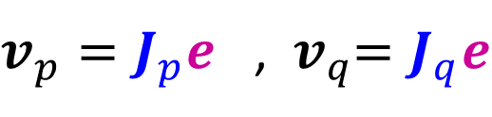
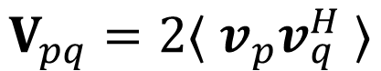
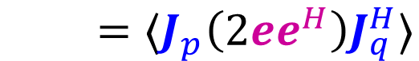
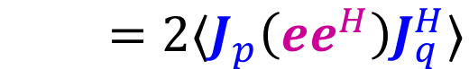
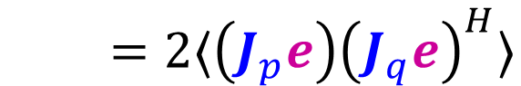
Correlation
$v_{p}=J_{p}e$ , ${ v}_{q}=J_{q}e$
$$V_{pq}=2⟨ v_{p}v_{q}^{H} ⟩$$
$=2⟨\left(J_{p}e\right){\left(J_{q}e\right)}^{H}⟩$
$=2⟨J_{p}\left(ee^{H}\right)J_{q}^{H}⟩$
$=⟨J_{p}\left(2ee^{H}\right)J_{q}^{H}⟩$

Slide 9
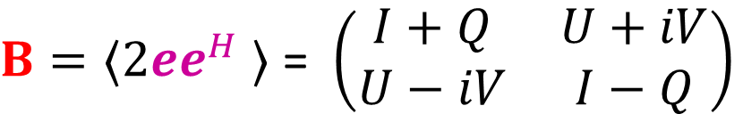



Coherency, or Brightness
$$V_{pq}=⟨J_{p}\left(2ee^{H}\right)J_{q}^{H}⟩$$
By definition, the coherency, or brightness, B, is given by:
$B=⟨2ee^{H}$ $⟩$ = $\left(\begin{matrix}I+Q & U+iV \\ U−iV & I−Q\end{matrix}\right)$
$⟨ee^{H}$ $⟩$ is the coherence of the electromagnetic field with itself,
and is described by the Stokes parameters $I, Q, U, V$
$$V_{pq}= {J_{p} B J}_{q}^{H}$$

Slide 10

Radio-Interferometric Measurement Equation (RIME)
Visibility
Brightness
$$V_{pq}={J_{p} B J}_{q}^{H}$$
Jones matrices
$$\left(\begin{matrix}v_{aa} & v_{ab} \\ v_{ba} & v_{bb}\end{matrix}\right)=\left(\begin{matrix}j_{11a} & j_{12a} \\ j_{21a} & j_{22a}\end{matrix}\right)\left(\begin{matrix}I+Q & U+iV \\ U−iV & I−Q\end{matrix}\right){\left(\begin{matrix}j_{11b} & j_{12b} \\ j_{21b} & j_{22b}\end{matrix}\right)}^{H}$$

Slide 11

Component Jones matrices
The Jones matrix for an antenna is a product of several component Jones
matrices, corresponding to different corrupting effects along the signal path
Example:
$$J=B G D E P T$$
Bandpass
gain
Instrumental
gain
Polarization
leakage
Primary
beam
Parallactic angle
feed rotation
Ionospheric
Faraday rotation

Slide 12

Component Jones matrices
Jones chain:
$$J= J_{n} J_{n−1} ⋯ J_{2} J_{1}$$
Later
in signal path
Earlier
in signal path

Slide 13


Component Jones matrices
Source
Propagation effects
Jones matrix, $J$
$$J_{n} { J}_{n−1} ⋯ J_{2} J_{1}$$
Earlier
in signal path
Antenna
Later
in signal path

Slide 14



Component Jones matrices
Antenna p :
$$J_{p}= J_{pn} J_{p(n−1)} ⋯ J_{p2} J_{p1}$$
Antenna q :
$$J_{q}= J_{qn} J_{q(n−1)} ⋯ J_{q2} J_{q1}$$
Visibility
Brightness
$$V_{pq}={J_{p} B J}_{q}^{H}$$
Jones matrices
$$V_{pq}=J_{pn} J_{p(n−1)}⋯ J_{p2} J_{p1} B J_{q1}^{H} J_{q2}^{H} ⋯{ J}_{q\left(n−1\right)}^{H} J_{qn}^{H}$$
$$V_{pq}= J_{pn}\left({ J}_{p\left(n−1\right)}\left(⋯\left(J_{p2}\left(J_{p1} B J_{q1}^{H}\right)J_{q2}^{H}\right)⋯\right)J_{q\left(n−1\right)}^{H}\right)J_{qn}^{H}$$

Slide 15


Calibration
Calibration: Determining and correcting for propagation effects
in order to compute the brightness.
i.e., solve for Jones matrices $J$ to compute $B$:
Visibility
Brightness
$$V_{pq}={J_{p} B J}_{q}^{H}$$
Jones matrices
$$B= J_{p}^{−1}V_{pq}{\left(J_{q}^{H}\right)}^{−1}$$

Slide 16

Direction-independent and direction-dependent effects
Propagation effects can be of two kinds:
Direction-independent effects
Direction-dependent effects
These effects can be represented by different Jones matrices:
$$J=G E$$
Final Jones matrix
Direction-independent
effects
Direction-dependent
effects

Slide 17



Direction-independent and direction-dependent effects
$$J=G E$$
Final Jones matrix
Direction-independent
effects
Direction-dependent
effects
Visibility-plane effects
Image-plane effects
$$V_{pq}={J_{p} B J}_{q}^{H}$$
$$V_{pq}=G_{p}\left(E_{p}BE_{q}^{H}\right)G_{q}^{H}$$

Slide 18

Direction-independent and direction-dependent effects
$$J=B G D E P T$$
Bandpass
gain
Instrumental
gain
Polarization
leakage
Primary
beam
Parallactic angle
feed rotation
Ionospheric
Faraday rotation
Direction-dependent
effect
Direction-independent
effects

Slide 19

Direction-independent effects
Source 1
Source 2
$$G$$
Same in all directions
Antenna

Slide 20

Direction-dependent effects
Source 1
Source 2
$$E$$
Varies with direction
Antenna

Slide 21



Structure of Jones matrices
Most Jones matrices have a simple form:
$J_{rotation}=\left[\begin{matrix}e^{jθ} & 0 \\ 0 & e^{−jθ}\end{matrix}\right]$
$J_{leakage}=\left[\begin{matrix}1 & D^{R} \\ D^{L} & 1\end{matrix}\right]$
$J_{gain}=\left[\begin{matrix}G^{R} & 0 \\ 0 & G^{L}\end{matrix}\right]$
(in a circularly polarized basis)

Slide 22



Rotation matrices
$J_{rotation}=\left[\begin{matrix}e^{jθ} & 0 \\ 0 & e^{−jθ}\end{matrix}\right]$
Examples:
Parallactic angle
$$P=\left[\begin{matrix}e^{−jα} & 0 \\ 0 & e^{jα}\end{matrix}\right]$$
Parallactic angle feed rotation:
$$T=\left[\begin{matrix}e^{jχ} & 0 \\ 0 & e^{−jχ}\end{matrix}\right]$$
Ionospheric Faraday rotation:
Faraday rotation angle

Slide 23


Leakage matrices
$J_{leakage}=\left[\begin{matrix}1 & D^{R} \\ D^{L} & 1\end{matrix}\right]$
Examples:
$$D=\left[\begin{matrix}1 & d^{R} \\ d^{L} & 1\end{matrix}\right]$$
Polarization leakage:
Polarization leakage terms

Slide 24



Gain matrices
$J_{gain}=\left[\begin{matrix}G^{R} & 0 \\ 0 & G^{L}\end{matrix}\right]$
Examples:
$$G=\left[\begin{matrix}g^{R} & 0 \\ 0 & g^{L}\end{matrix}\right]= \left[\begin{matrix}a^{R}e^{{jφ}^{R}} & 0 \\ 0 & a^{L}e^{{jφ}^{L}}\end{matrix}\right]$$
Instrumental gain:
$$B=\left[\begin{matrix}B^{R} & 0 \\ 0 & B^{L}\end{matrix}\right]= \left[\begin{matrix}b^{R}(ν)e^{{jψ}^{R}(ν)} & 0 \\ 0 & b^{L}(ν)e^{{jψ}^{L}(ν)}\end{matrix}\right]$$
Bandpass gain:

Slide 25
Direction dependent effects: Primary beam
The primary beam of the antenna is the most important
direction-dependent effect.
Becomes important in wide-field, wide-band observations.
The primary beam pattern has a multiplicative effect in the
image plane, convolutional effect in the visibility plane.
We will consider the example of a JVLA (Jansky Very Large Array)
antenna here.

Slide 26


Primary beam amplitude variation with distance from center
Beam gain
Distance
Horizontal cross-section of the beam
through the center

Slide 27
JVLA primary beam
First null
Main lobe
First sidelobe
1⁰
(at 1410 MHz)

Slide 28

Primary beam rotation
An EVLA antenna has an alt-azimuth mount;
the primary beam rotates during the course of an observation

Slide 29


Variation of primary beam with frequency
The beam pattern becomes more compact
with increasing frequency
Beam gain
Frequency
Beam-induced spectral variation
for the source represented by a dot

Slide 30


Incorporating primary beam in calibration
EVLA image of the field around the radio source 3C147
Calibration without primary beam included
Calibration with primary beam included

Slide 31

Effect of primary beam on noise over the field of view
EVLA image of the field around the radio source 3C147

Slide 32

Calibration procedure
Start with visibility data,$V_{pq}$, and initial brightness model, $B$.
Solve $\min_{J}\left|V_{pq}−{J_{p} B J}_{q}^{H}\right|$for $Js$.
Calculate residual visibility data $V_{pq}^{residual}= V_{pq}−{J_{p} B J}_{q}^{H}$.
Image $V_{pq}^{residual}$ to create a residual image, $I$.
Perform a source-finding procedure to find sources in the residual image, and add these to the initial model $B$ to form a new, updated model $B^{new}$.
Set $B$ = $B^{new}$ , and repeat steps 2-5 until the residual image $I$ is noise-like.

Slide 33


Differential gains
Differential gain solutions encompass the unknown and unmodeled direction-dependent effects in the signal path.
The Jones matrix in the direction of source $s$ is then given by:
$$J^{(s)}=G E {∆E}^{(s)}$$
Final Jones matrix
in the direction
of source s
Direction-independent
effects
Known and modeled
direction-dependent
effects
Differential gain:
Unknown/unmodeled
direction-dependent
effects in the direction
of source s

Slide 34
Differential gains
Differential gain solutions are computed (in the direction of a few bright sources) and applied after regular calibration in order to correct for leftover, uncalibrated effects.

Slide 35

Incorporating differential gains in calibration
(Without primary beam incorporated in calibration)
Without differential gain solutions
With differential gain solutions applied

Slide 36
Differential gains
As more corrupting effects are modeled and accounted for, the calibration becomes more comprehensive, and differential gain solutions approach unity.

Slide 37




Incorporating primary beam in calibration
Differential gain plots
Without primary beam
With primary beam
Flattened differential gain curves, $\sim 1$
over the whole range
Residual variation due to
remaining uncorrected direction-dependent
effects (like antenna pointing errors)
2
2
Differential gain
amplitude
Differential gain
amplitude
1
1
0
0
Time
Time

Slide 38
References
Thompson, A. R., Moran, J. M., and Swenson, Jr., G. W. (2001), Interferometry and Synthesis in Radio Astronomy, 2nd Edition
G. B. Taylor, C. L. Carilli, & R. A. Perley, editors (1999), Synthesis Imaging in Radio Astronomy II, volume 180 of Astronomical Society of the Paciﬁc Conference Series
14th Synthesis Imaging Workshop lecture slides (2014), National Radio Astronomy Observatory, Socorro, New Mexico, USA
Oleg Smirnov’s RIME lecture from 3GC3 Workshop and Interferometry School (2013), Port Alfred, South Africa

Slide 39
References (continued)
Smirnov, O. M. (2011). Revisiting the radio interferometer measurement equation. I. A full-sky Jones formalism. Astronomy & Astrophysics, Volume 527, A106
Smirnov, O. M. (2011). Revisiting the radio interferometer measurement equation. II. Calibration and direction-dependent effects. Astronomy & Astrophysics, Volume 527, A107
Smirnov, O. M. (2011). Revisiting the radio interferometer measurement equation. III. Addressing direction-dependent effects in 21 cm WSRT observations of 3C 147. Astronomy & Astrophysics, Volume 527, A108

Slide 40
References (continued)
Hamaker, J. P., Bregman, J. D., and Sault, R. J. (1996). Understanding radio polarimetry. I. Mathematical foundations. A&AS, 117, 137–147
Sault, R. J., Hamaker, J. P., and Bregman, J. D. (1996). Understanding radio polarimetry. II. Instrumental calibration of an interferometer array. A&AS, 117, 149–159
Hamaker, J. P. and Bregman, J. D. (1996). Understanding radio polarimetry. III. Interpreting the IAU/IEEE deﬁnitions of the Stokes parameters. A&AS, 117, 161–165
Hamaker, J. P. (2000). Understanding radio polarimetry. IV. The full-coherency analogue of scalar self-calibration: Self-alignment, dynamic range and polarimetric ﬁdelity. A&AS, 143, 515–534

